Slide 1

AI MEDBOT-driven preliminary treatment suggestions based
on user-reported symptoms
SUBMITTED BY
Abi Neyathii R S (721922104003)
Kaviya Dharshini M (721922104057)
Dhivya K(721922104030)
Divya Dharshini M (721922104033)
SECOND REVIEW -2026
GUIDED BY
Dr. Tamizharasu
Department of Computer Science and Engineering

Slide 2
CONTENT
Abstract
Introduction
Literature Survey
Existing Technology
Proposed Technology
Scope of the Project
Merits
Demerits
Conclusion

Slide 3
ABSTRACT
AI MEDIBOT is an intelligent healthcare platform designed to streamline patient care and hospital management through AI-driven automation.
By integrating Machine Learning (ML) and Natural Language Processing (NLP), the system analyzes user-reported symptoms to provide preliminary medical guidance and identify potential health conditions.
The platform offers a unified suite of services, including real-time doctor appointment booking, specialist recommendations, and an integrated medical e-commerce module for purchasing healthcare products.
Developed using a Python-based backend (Flask/Django), the system focuses on reducing patient wait times and improving healthcare accessibility in underserved regions.

Slide 4
INTRODUCTION
The Problem (Current Challenges)
System Overload: Rising population and a shortage of medical professionals.
Inaccessibility: Long wait times and difficulty booking timely appointments.
Information Gap: Lack of immediate, reliable medical guidance before hospital visits.
Fragmented Care: Patients struggle to find the right specialists and obtain medications through a single source.
The Solution (AI MEDIBOT)
Unified Digital Platform: Bridges the gap between patients and providers through an all-in-one assistant.
Smart Symptom Analysis: Uses NLP and Machine Learning to provide preliminary treatment suggestions.
Dynamic Scheduling: Facilitates real-time appointment booking and doctor availability tracking.
Integrated E-Pharmacy: Includes a module for purchasing prescribed medicines and health products.
Targeted Referrals: Recommends specific hospitals or specialists based on analyzed health needs.

Slide 5
LITERATURE SURVEY
Year | Authors | Study/Title | Methodology | Key Contribution
2021 | Mizra Moiz Baig et al. | A review on smart healthcare using medical chatbots | The study analyzed chatbot architecture, NLP techniques, machine learning methods. | Showed how medical chatbots can improve smart healthcare by giving 24/7 support, faster response and remote patient monitoring.
2022 | Sanjay Chakraborty et al. | An AI-Based Medical chatbot model for Infectious Disease prediction | (NLP) and a deep learning model with multilayer perceptron/LSTM. | Developed an AI chatbot that predicts infectious diseases with about 94% accuracy and gives treatment suggestions, nearby doctor details and hospital information.
2023 | Ahmad A.Alzahrani | Developing A primary healthcare diagnosis system | Built a primary healthcare diagnosis system using symptom. | Helped users get early diagnosis and primary healthcare advice without visiting a hospital immediately, reducing time and improving accessibility.
2024 | Smriti Sharma et al. | MEDIBOT-An AI Powered Chatbot | Used an AI-powered chatbot framework with NLP, symptom analysis and medical database integration. | Introduced a user-friendly medical assistant called MEDIBOT that provides instant health guidance, symptom checking and basic treatment recommendations.
2024 | Sreedar kumar et al. | Medical chatbot assistance for primary clinical guidance | Used a clinical guidance chatbot with NLP and rule-based decision support. | Improved primary clinical guidance by giving users quick recommendations, helping them decide whether home care or doctor consultation is needed.

Slide 6
EXISTING TECHNOLOGY
Current healthcare platforms mainly offer:
• Manual hospital appointment systems • Basic teleconsultation apps • Separate medicine delivery services • No AI-based symptom guidance
Limitations:
Long waiting times
No intelligent health analysis
Fragmented platforms
Poor patient convenience
Patients must use multiple services for one medical need.

Slide 7
LIMITATION OF EXISTING SYSTEM
Manual appointment booking causes long waiting time.
Separate applications are needed for doctor consultation, medicine purchase, and appointment booking.
No AI-based symptom analysis is available.
Users do not get immediate preliminary treatment suggestions.
Difficult to identify the correct specialist or hospital.
Most systems do not provide real-time doctor availability.
Rural and remote users have limited access to healthcare services.

Slide 8
PROPOSED TECHNOLOGY
AI MEDIBOT introduces a smart integrated healthcare system featuring:
AI symptom analysis using ML & NLP
Real-time doctor availability
Appointment booking automation
Hospital & specialist recommendation
Medical shopping module
Technology Stack:
Python backend
Flask/Django framework
Machine Learning models
Secure database system
This creates a centralized, intelligent healthcare platform.

Slide 9
ADVANTAGES OF PROPOSED SYSTEM
AI-based symptom analysis using Machine Learning and NLP.
Quick preliminary treatment suggestions.
Real-time doctor appointment booking.
Hospital and specialist recommendation based on symptoms.
Integrated medical shopping / e-pharmacy module.
Single platform for all healthcare-related services.
Reduced patient waiting time.
Faster decision-making and reduced manual work.

Slide 10
SOFTWARE REQUIREMENTS
HARDWARE REQURIEMENTS
Operating System
Windows 10 / Windows 11 / Linux
Frontend
HTML
CSS
JavaScript
Bootstrap
Backend
Python
Flask or Django Framework
Database
MySQL / SQLite
AI & ML Libraries
Scikit-learn, Pandas, NumPy
Minimum Hardware
Processor: Intel Core i3 or above
RAM: 4 GB minimum
Storage: 100 GB free space
Internet connection
Recommended Hardware
Processor: Intel Core i5 / Ryzen 5
RAM: 8 GB or more
SSD storage* Webcam and microphone (for future telemedicine feature)

Slide 11
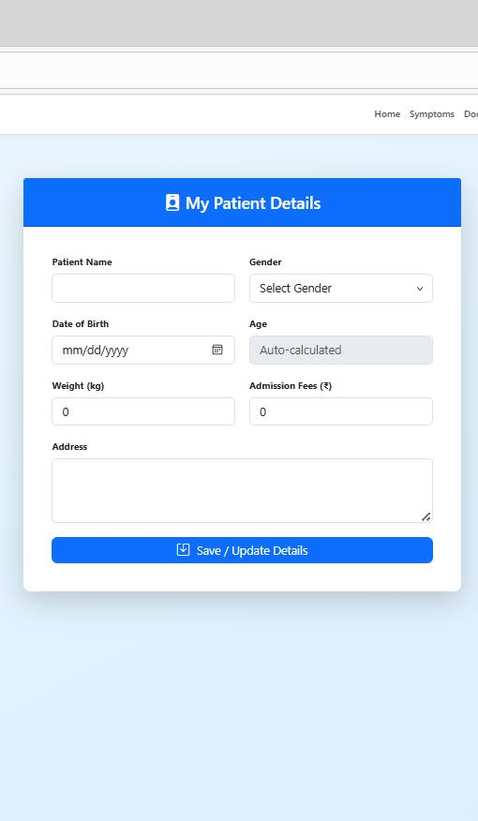
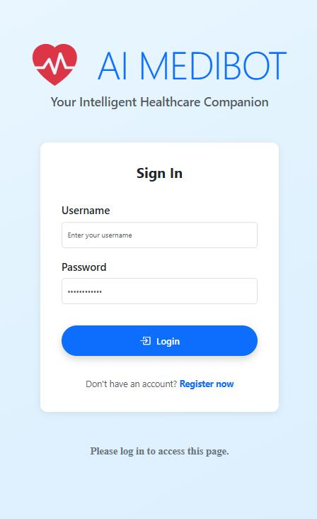
Apps Frontend For Second Review

Slide 12
Backend-Focus Session Logic (prototype stage)
Implemented Backend parts
User Authentication Module
Symptom Processing Module
Machine Learning Prediction Module
Technology Used for Backend
Python
Flask / Django
REST API
MySQL / SQLite
Next Phase Planned for Backend
Telemedicine video consultation integration
Voice-based symptom input
Chatbot support using Generative AI

Slide 13
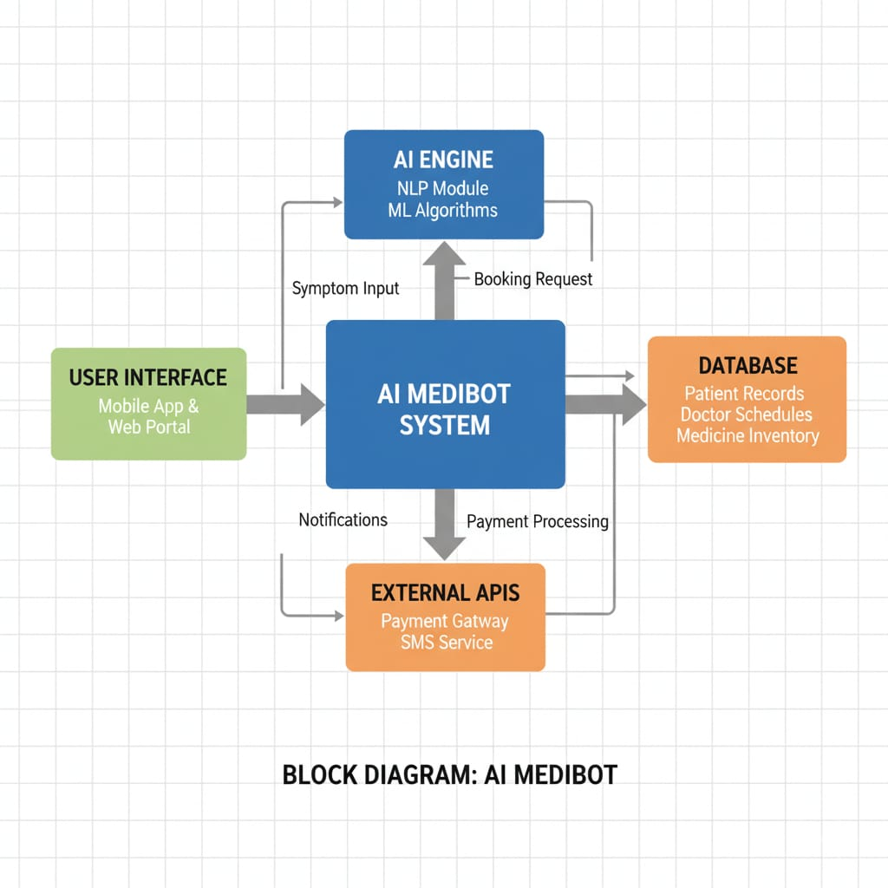
Overall System Architecture

Slide 14
SCOPE OF THE PROJECT
AI MEDIBOT can be expanded for:
• Telemedicine video consultations
• Voice-based medical assistant
• IoT health monitoring integration
• Emergency alert systems
• Smart hospital management
The system is scalable for future healthcare innovations.

Slide 15
CONCLUSION
AI MEDIBOT successfully demonstrates how Artificial Intelligence can modernize healthcare services.
By integrating:
Symptom analysis
Appointment booking
Hospital recommendations
Medical shopping
the system improves efficiency, accessibility, and patient convenience.
With future enhancements such as teleconsultation and smart health monitoring, AI MEDIBOT has strong potential to become a complete intelligent healthcare ecosystem.

Slide 16
THANK YOU

